Slide 1

From Listings to Insights: Used Car Market Analysis

Slide 2

Introduction
CARS24 is an online platform for buying and selling used cars. This project analyzes used car data to understand pricing patterns, customer preferences, and market trends. The goal is to help in setting accurate car prices and making better business decisions using data insights.

Slide 3

Agenda
Business Problem
Business Objective
Problem Statement
Data Preprocessing
Exploratory Data Analysis (EDA)
Hypothesis Testing
Recommendations
Challenges
Conclusion

Slide 4

Business Problem
CARS24 faces the real-world problem of setting and recommending accurate, market-driven prices for used cars so that sellers can list their vehicles at competitive prices for faster sales without loss, while buyers can confidently identify fair-priced, high-value cars without the risk of overpaying.CARS24 faces the
Problem Statement
CARS24 needs a data-driven way to analyze used car listings across different cities to understand market demand, pricing patterns, and customer preferences in order to optimize car prices, increase faster sales, and maximize profit.

Slide 5

Business Objective
The main objective of this project is to collect real-time used car data from the CARS24 website and analyze it to understand market trends, pricing patterns, and customer demand so that better business decisions can be made.

Slide 6
Data Pre-Processing
Removed duplicate records
Converted KM to numeric (removed “km” and commas)
Converted Price to numeric rupees (removed ₹ and “lakh”)
Extracted State Code from Registration (DL-7C → DL)
Cleaned text columns (lowercase + removed extra spaces)
Standardized Fuel values (Petrol, Diesel, CNG, Electric)
Standardized Transmission values (Manual, Automatic)
Split Car into Year, Brand, Model
Dropped original Car column after split
Final dataset is fully structured and analysis-ready

Slide 7
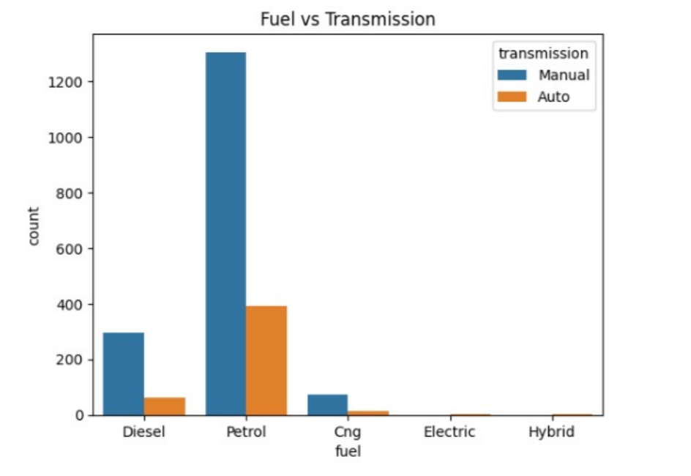
Exploratory Data Analysis
UNI-Variant Analysis
How does the distribution of fuel types vary between Manual and Automatic transmission cars?
Insights:
Petrol cars dominate in both Manual and Automatic transmissions.
Diesel vehicles are the second most common and mostly Manual.
Automatic cars are mainly preferred with Petrol fuel.
CNG, Electric, and Hybrid vehicles have very low counts.

Slide 8
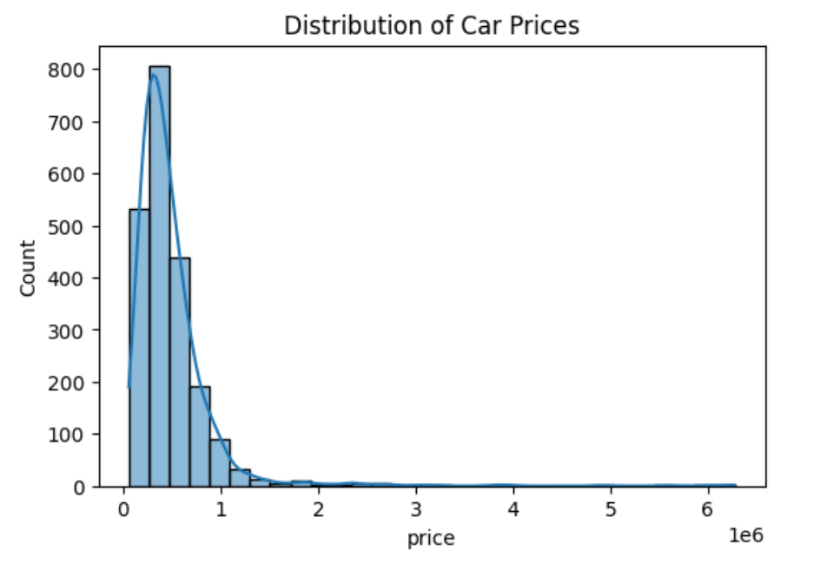
What is the overall distribution pattern of car prices in the CARS24, and where does most of the market demand lie?
Insights:
Prices are highly right-skewed → most cars are in the low to mid price range.
A small number of very high-priced cars (outliers) exist.
Median price is more reliable than mean for pricing decisions.
Pricing models should focus mainly on the mass-market segment.

Slide 9
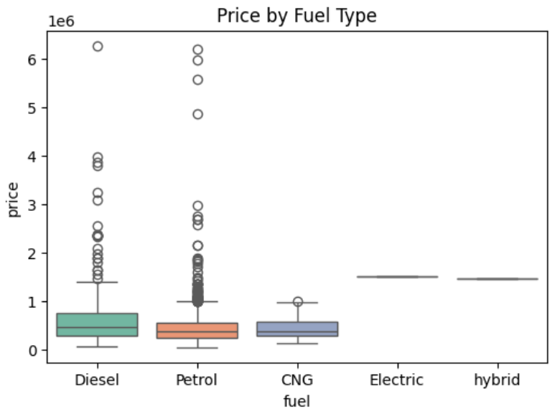
Bi-Variant Analysis
Which fuel type gives higher resale value, and how does car price vary across different fuel types?
Insights:
Diesel cars generally have higher resale prices than Petrol and CNG.
Electric and Hybrid cars show premium pricing, though their sample size is small.
CNG cars have the lowest resale value, suitable for budget buyers.
Fuel type is a strong factor and must be included in price prediction.

Slide 10
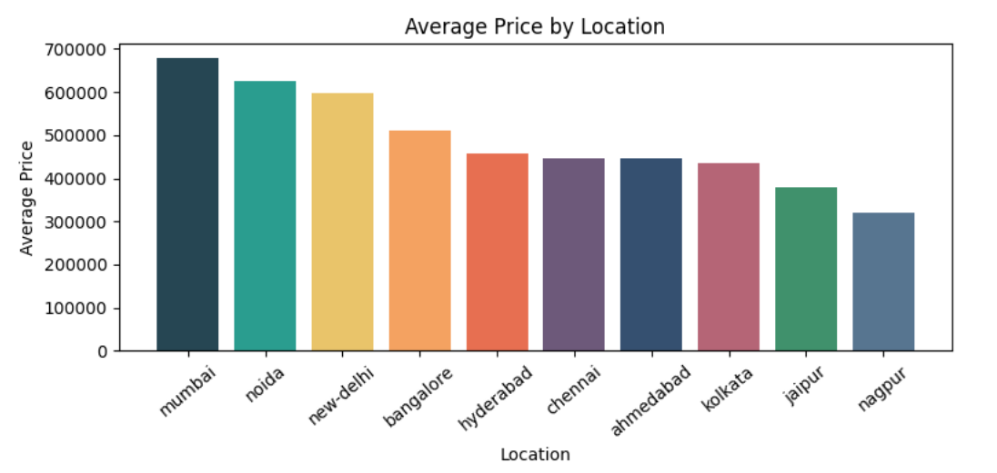
Which city/location has the highest average car prices, and how does pricing vary across different locations?
Insights:
Mumbai, Noida, and New Delhi have the highest average car prices → premium demand markets.
Nagpur and Jaipur have the lowest prices → more price-sensitive markets.
Same car should have different price recommendations based on location.
Location is a critical factor in CARS24’s pricing strategy.

Slide 11
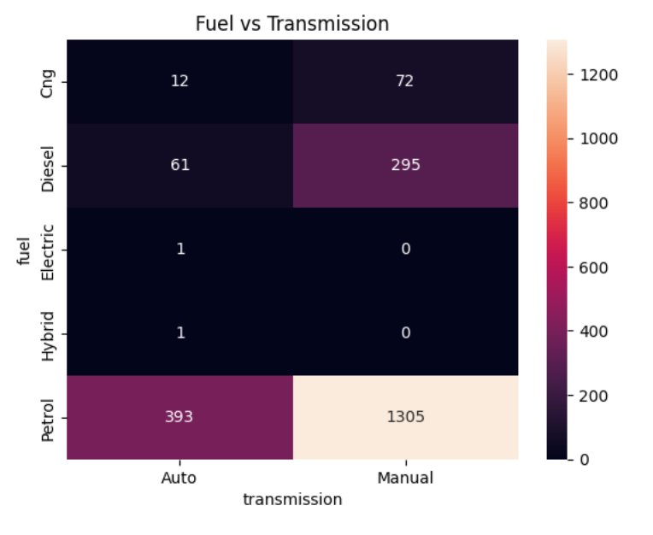
Multi-Variant Analysis
Is there an association between fuel type and transmission type in cars?
Insights:
Petrol cars dominate both Manual and Auto transmissions → main market segment.
Manual transmission is far more common across all fuel types.
Diesel cars are mostly Manual → utility and cost-focused buyers.
Fuel + Transmission combination must be used in pricing and inventory planning.

Slide 12
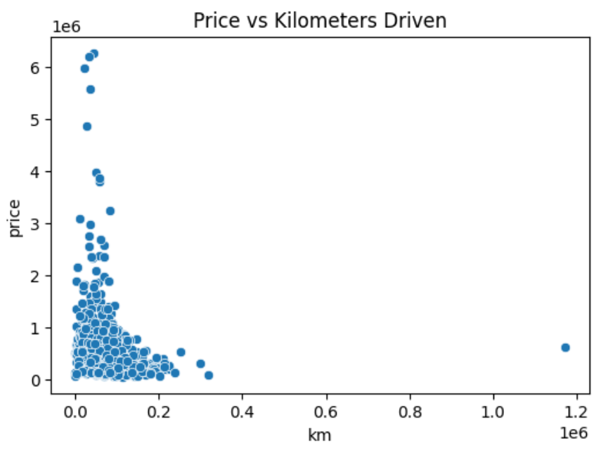
How does the number of kilometers driven affect the resale price of a car?
Insights:
Price decreases as kilometers driven increase → clear depreciation effect.
Low-KM cars command significantly higher resale value.
High-KM cars fall into the budget segment.
Kilometers driven is a critical factor in pricing models.

Slide 13
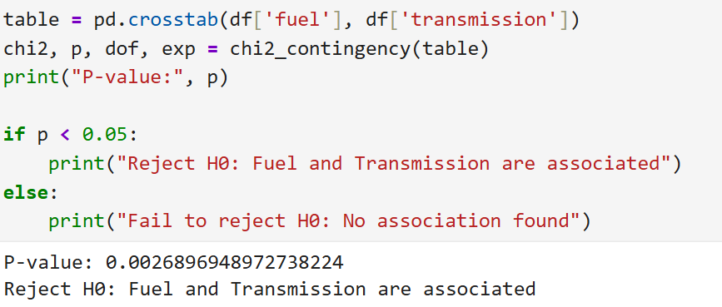
Hypothesis Testing
Is fuel type associated with transmission type (Manual vs Auto)?
Insights:
Fuel type and transmission are related → buyer preference pattern exists.
Petrol dominates both Manual and Auto → main market segment.
Fuel + Transmission must be combined in pricing and recommendations.
Interpretation:
If P-value < 0.05 → Reject H0 → Fuel type and transmission are related.
If P-value ≥ 0.05 → Fail to reject H0 → Fuel type and transmission are independent.

Slide 14
Insights:
Most cars fall in the low–mid price range → CARS24 is mainly a mass-market platform
Diesel cars give higher resale value than Petrol and CNG.
Electric & Hybrid are premium, but very limited in volume.
Location strongly impacts price → Mumbai, Noida, Delhi are high-value markets.
Kilometers driven reduces price → strongest depreciation factor.
Fuel and Transmission are related → buyer preference pattern exists.
Petrol + Manual dominates the market → main inventory segment.

Slide 15
Recommendations
Prefer cars from 2017–2021 models
Choose Maruti or Hyundai for easy resale and low maintenance
Automatic cars have better future demand
CNG cars give best savings for daily use
Keep mileage below 1.5 lakh KM
Avoid very cheap, high-maintenance cars
Metro city cars usually have better resale
Service history increases car value

Slide 16
Challenges
I have faced Many challenges During doing the Project that include:
Data Scraping
Kernal crash
Filtering the data
Optimizing visuals

Slide 17
Conclusion
Built a data-driven view of the Indian used car market using 2,000+ listings.
Focused on the middle-class segment (price < ₹10L, mileage < 1.6L KM).
Converted raw listings into actionable pricing insights.
Found that manufacturing year and transmission type impact price more than small mileage differences.
Identified 4–6 year old cars as the best value-for-money segment.
Maruti and Hyundai emerged as the most liquid and fastest-selling brands.
Reduced market guesswork through data-backed decisions.
Helps buyers minimize risk and make smarter purchase choices.

Slide 18


